Slide 1
VBA Programming (cont.)
Week 4, Day 15

Slide 2
Reminder: make sure “Macros” are enabled
MS Office locks out custom programming by default – without warning you about it!
Go to File → Options → Trust Center → Trust Center Settings → Macro Settings
Check either “Disable all macros with notification” (will ask you whether to allow them each time you open a file with macros) or check “Enable all macros”
You need to enable macros BEFORE opening your workbook – the change does not affect files already open

Slide 3
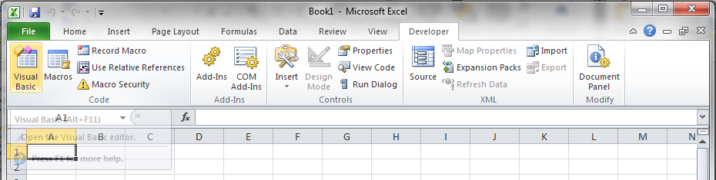
Reminder: Make“Developer” tab visible & go to VB Editor
If the Developer tab is not visible,
Go to File → Options → Customize Ribbon
On the right-hand pane, check “Developer” under “Main Tabs” & click “OK”
Go to Developer → Visual Basic (or press Alt + F11)

Slide 4
Reminder: All code goes in a “Module”
In VBA, Insert a new Module
Do NOT insert a “Class Module”
All VBA code is written in modules
All of your code for in-class exercises or homework should be in a single module!
A workbook can contain multiple modules, just as it can contain multiple worksheets
All worksheets in a workbook have access to functions written in any or all of the modules in that same workbook only

Slide 5
Reminder: Sub Procedure Syntax
VBA Sub Procedure Syntax
Sub MySubName() Note: nothing in the parenthesis!
<Inputs>
<Calculations>
<Outputs>
End Sub
Sub procedure name has same rules as variable names
NO arguments in a Sub procedure — for our purposes, parenthesis are just place-holders (like PI function in Excel)
No built-in provision for input & output!

Slide 6
“Object-Oriented” Programming
Visual Basic is “object oriented”
Items are referred to in a cascade from general to specific, separated by periods
An analogy would be the description of a specific command/button in the tool ribbon
The most general object in VBA for Excel is the Excel “Application”
This is implicitly assumed and we don’t need to worry about it
Other objects:
Workbook, Worksheet, Cells, etc.

Slide 7
Object-Oriented Shortcuts
Don’t need to refer to the whole structure from the Excel application on down
Example: Range(“A1”).Font.Name=“Arial” (Application.Workbook(“Book1”).Worksheet(“Sheet1”) .Range… is assumed if Sheet1 in Book1 is “active”.)
Referring to the currently selected cell on the currently selected worksheet
Example: If cell B7 is currently selected, Range(“B7”) and ActiveCell mean the same thing, (the Application.Workbook(“Book1”).Worksheet(“Sheet1”)... part is assumed again)

Slide 8
Input Syntax
From an excel cell:
Range(“A3”).Select
a = ActiveCell.Value
From an Input box:
b = Val(InputBox(”What is b?”))
The Val( ) function converts the text output of the InputBox function into a number.
Using .Offset (we’ll cover this more later)
ActiveCell.Offset(1, 0).Select
b = ActiveCell.Value

Slide 9
Output Syntax
To an Excel cell:
Range(“A3”).Select
ActiveCell.Value = Sum
To a Message box:
MsgBox “The answer is ” & Sum
(For more details on using message box and Inputbox, type “MsgBox function” and “Inputbox function” in VBA help )

Slide 10
Text “arithmetic”
VBA can perform operations on strings of text similar to arithmetic
Concatenate two strings of text using the ampersand (&)
SomeText = “Hello ” & “World!”
NewStringVar = StringVar1 & StringVar2

Slide 11
In-Class Exercise #4
Write a Sub procedure to ask your name and reply, “Hello, …”
Sub Hello_Wk4_IC4()
’ Have VBA ask your name and greet you
’ Ask your name using an input box
MyName = InputBox(“Enter your name”)
’ Output to an Excel cell
Range(“A5”).Select
ActiveCell.Value = “Hello, ” & MyName
‘ Output to a Message box
MsgBox “Hello” & MyName
End Sub
Use comments (marked by an apostrophe) in all your code!

Slide 12
In-Class Exercise #5
Write a program in VBA to add three numbers
Develop Flowchart and PseudoCode
Write the code and place appropriate comments
Algorithm:
Input values for a, b, and c
Get a from a spreadsheet cell
Get b from an input box
Assign c directly in your code
Add the three values together
Output the sum

Slide 13
FlowChart and PseudoCode
Start
Start Sub procedure
Input values for a, b, c
a → input from spreadsheet
b → input from Input Box
c →input assigned in code
Calculate trisum = a + b + c
Output trisum
trisum → output to spreadsheet
→ output to Message Box
End Sub procedure
a
b
c
trisum = a+b+c
trisum
End

Slide 14
In-class Exercise #6
Write a program to take diameter, d, from Excel spreadsheet cell B8 and get user input for the value of height, h, (then write the value in Excel cell B9). Write and call Functions in the Sub to calculate the volume, lateral surface area, base surface area & total surface area of a right circular cone. Display the results in both a message box and also in cells B11 & B12.
Cone Volume: V = ¹/₃ π r² h
Cone Surface Area: A_{L} = π r (r² + h²)^{½} A_{B} = π r²

Slide 15
In-class Exercise #6 (cont.)
What about pi?!
Excel has a function: =PI(), but VBA does not
Three choices:
Manually assign value of pi pi = 3.14159265 or pi = 22/7 (approx. for pi, good to 3 decimal places)
Use arctan (inverse tan) function available in VBA: pi = 4 * Atn(1)
Try to get to Excel’s pi() function
We can use a limited number of Excel’s worksheet functions in VBA, PI() is one of them: pi = WorksheetFunction.Pi()
We can use “pi” as the variable name, because it’s not a “reserved word” in VBA

Slide 16
Debugging
Debugging – Checking for syntax errors, execution errors, logic errors etc.
In VBA, click on Debug tab, then Step into
Hit ‘F8’ to move the cursor down and keep checking each line. It takes you through the lines in the order in which the program is executed.
Move your cursor to a variable and it will show the value assigned if any
In the VB Editor, go to the “View” menu and select “Locals Window”
The name, type, and value of all variables will be shown
Hit ‘F9’ or click on the grey bar to the right of the code to set a break. A subroutine will halt whenever it encounters a break

